Slide 1


YOUR QUALITY PARTNER FOR SOFTWARE SOLUTIONS
5G Overall Architecture
Sierra Wireless Validation Team
TMA Solutions
www.tmasolutions.com

Slide 2
Agenda
Introduction 5G Overall Architecture
Network Slicing
Core Network Slicing
Transport Network Slicing
5G Security Architecture
3GPP 5G Deployment Options
Reference
Q & A

Slide 3
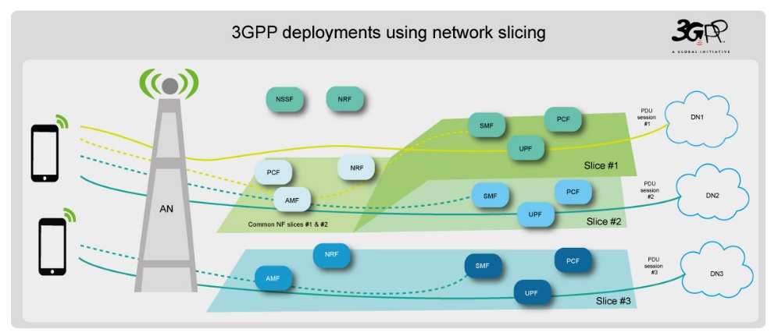
Introduction 5G Overall Architecture
Notes:
Reference: abc.com

Slide 4
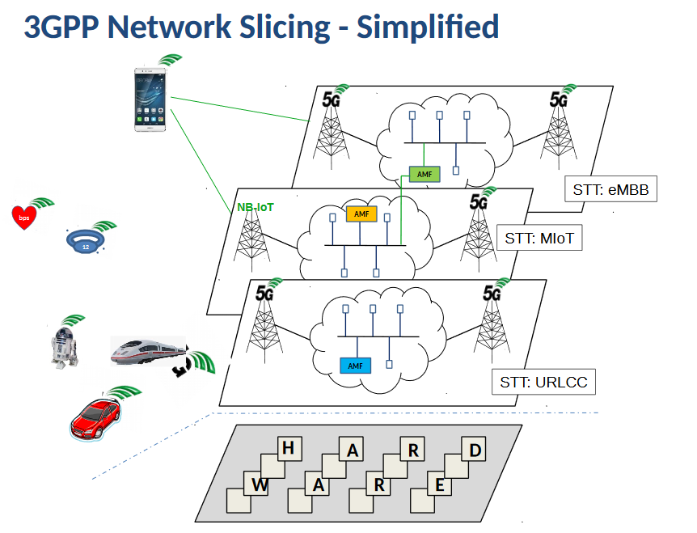
Network Slicing
Network Slicing is an end-to-end concept covering all network segments including radio networks, wire access, core, transport and edge networks.
The behavior of the network slice realized via network slice instance(s).
Notes:
The network slice is a composition of adequately configured network functions, network applications, and the underlying cloud infrastructure (physical, virtual or even emulated resources, RAN resources etc.), that are bundled together to meet the requirements of a specific use case, e.g., bandwidth, latency, processing, and resiliency, coupled with a business purpose.
Network Slicing is an end-to-end concept covering all network segments including radio networks, wire access, core, transport and edge networks.
The behavior of the network slice realized via network slice instance(s).

Slide 5
Network Slicing (cont.)
Notes:
The network slice comprises a subset of virtual network infrastructure resources and the logical mobile network instance with the associated functions using these resources.
It is dedicated to a specific tenant that, in turn, uses it to provide a specific telecommunication service (e.g. eMBB).

Slide 6
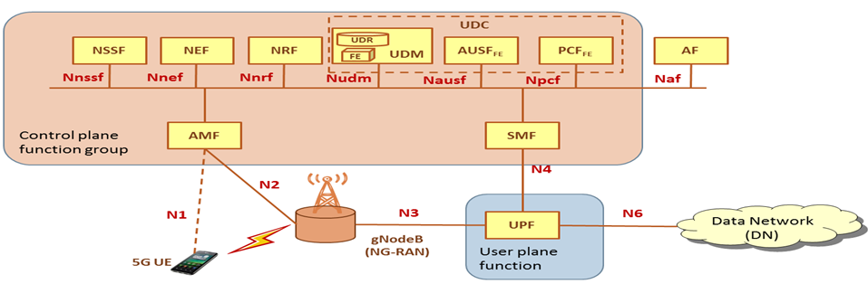
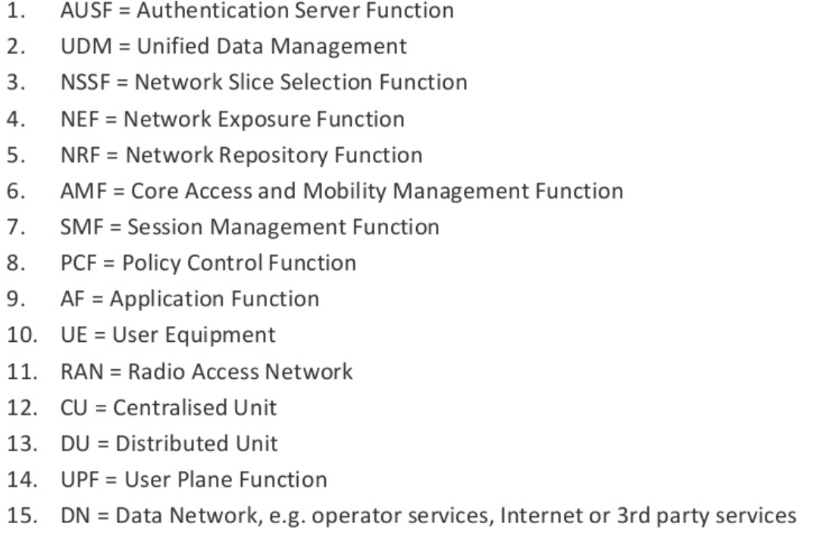
Core Network Slicing
Notes:
• Authentication Server Function (AUSF): supports authentication server function.
• Access and Mobility Management Function (AMF): access control, mobility control, transparent proxy for routing SM message.
• Unified Data Repository (UDR): storage and retrieval of data by the UDM, PCF or NEF.
• Unstructured Data Storage Network Function (UDSF): storage and retrieval of information as unstructured data by any NF.
• Network Exposure Function (NEF): expose the services and capabilities provided by 3GPP network functions.
• NF Repository Function (NRF): maintains NF profile, supports service discovery.
• Policy Control function (PCF): decides the policy and provides them to the control plane function.
• SMF (Session Management Function): manages the PDU session e.g. PDU session establishment, modify and release.
• Unified Data Management (UDM): authentication credential processing, access authorization, registration/ mobility management and subscription management.
• User plane Function (UPF): handles the user plane traffic, e.g. traffic routing & forwarding, traffic inspection and usage reporting, handling.
• Application Function (AF): interacts with the 3GPP Core Network (CN) to provide services.
• Network Slice Selection Function (NSSF): selects the NSI, determines the allowed network slice selection assistance information (NSSAI) and AMF set to serve the UE.

Slide 7
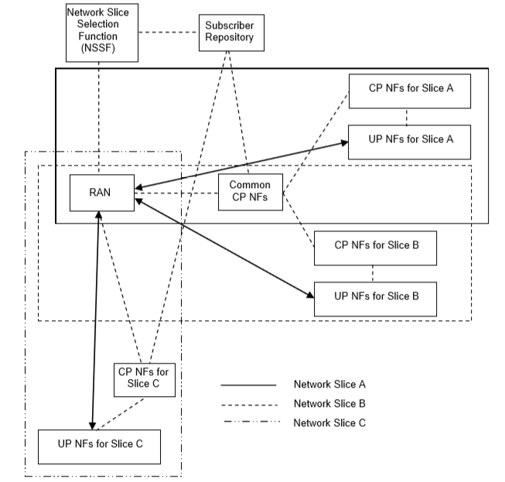
Core Network Slicing (cont.)
Notes:
One is the dedicated network slice and the other is the network slices sharing common CP NFs. Global network functions across multiple slices. Such functions are those related with multiple slices in the network, e.g., UE subscription repository function. The NSSF is such a common function provided to all network slices in a public land mobile network (PLMN). Common CP network functions for multiple slices with UE simultaneously connected. A UE can access multiple network slices at the same time. In this case, there should have a minimum set of NFs which can be flexibly expanded with additional NFs per slice requirement. The minimum set of common CP NFs should include AMF. The signaling (e.g., between UE and AMF function, and between new/target AMF function and old AMF function) can be reduced if mobility management (e.g. UE location update related management) is shared among different network slices when a UE simultaneously obtains services from different slices.

Slide 8
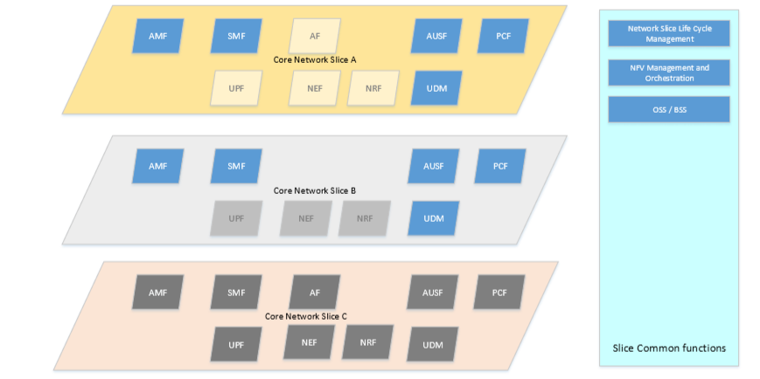
Core Network Slicing (cont.)
Notes:
An example of network slice with combination of shared and dedicated resources are illustrated in the figure, where each of the network slices have dedicated Network Functions (NFs) e.g. SMF, UPF, NEF, NRF & AF nodes. It may be possible to implement shared NF for AMF, AUSF, PCF & UDM (e.g. same operator implementing different network slice for MBB & mMTC use cases; where as an entirely dedicated set of all NFs are implemented for Slice C. While this is for illustrative purposes, it provides a perspective on the range of combinations that need to be possible to be configured for different network slices based on business-driven tops down requirements and capabilities of the resources that may need to be brought together as part of a network slice. Also evident from the diagram is the set of network functions instantiated for each of the network slices – slice B does not instantiate an AF.

Slide 9
Core Network Slicing Selection
Core Network Slicing Selection includes 3 following steps:
S-NSSAI and NSSAI (Network slice selection assistance information) for CN slicing selection
Serving AMF selection& Registration to a set of NSI
Selection of a particular NSI for the UE for establishing a PDU session
Notes:
From White Paper 3: End to End Network Slicing:
4.2.2.1 S-NSSAI and NSSAI for CN slicing selection
A collection of S-NSSAIs is called as NSSAI, and each S-NSSAI assists the network in selecting a particular NSI at run time. An S-NSSAI is comprised of: • A slice/service type: the expected network slice behaviour in terms of features and services; • A slice differentiator: the optional information that complements the slice/service type(s) to allow further differentiation for selecting an NSI from the potentially multiple NSIs that all comply with the indicated slice/service type. The UE may have the following different types of NSSAIs: • Configured NSSAI: The network(i.e. the HPLMN) may provide a Configured NSSAI per PLMN in the UE. It can be standardized value or PLMN specific value. • Allowed NSSAI: Upon successful completion of a UE's Registration procedure, the UE may obtain from the AMF an Allowed NSSAI for this registration area, which may include information of one or more S-NSSAIs . The UE shall use only the S-NSSAIs in the Allowed NSSAI corresponding to a Network Slice for the subsequent Network Slice selection related procedures in the registration area. • AS(layer) NSSAI: Upon successful Registration, the UE is provided with an AS NSSAI, and a Temporary ID by the serving AMF. The UE shall include this AS NSSAI in AS layer e.g. RRC Connection Establishment resulting from initial and mobility Registration messages but not Service Request to enable the (R)AN to route the NAS signalling between the UE and the appropriate AMF in case the Temporary ID is not valid.
4.2.2.2 Serving AMF selection& Registration to a set of NSI
When the UE initially accesses to the network , a set of network slices to serve the UE is determined first based on requested NSSAI provided by UE, i.e., the common network functions of the set of network slices, which at least includes an AMF, are determined. If the (R)AN can not select an appropriate AMF based on the information included in the AS message, the (R)AN will forward the registration request message to a default AMF. The default AMF retrives the UE subscription data and interacts with the NSSF (Network Slice Selection Function) to get information for selection of a new AMF to serve the UE. The default AMF or the (R)AN determines a target AMF as the UE’s serving AMF based on the information. After successful initial registration the UE is provided with a temporary identity that is provided by the UE in AS message during subsequent accesses to enable the (R)AN to route the NAS message to the appropriate AMF, as long as the temporary identity is valid. Otherwise the (R)AN uses the AS NSSAI included in AS message to select an appropriate AMF and forwards the NAS message to the selected AMF. If the (R)AN is not able to select an AMF based on the temporary identity or the AS NSSAI, the NAS message is forwarded to a default AMF and the default AMF interacts with the NSSF to determine the information for selection of a new AMF to serve the UE. AMF forwards the requested NSSAI with UE’s subscribed NSSAI retrieved from UDM to NSSF. Based on UE’s subscribed NSSAI, requested NSSAI (if have), registration area and local policy, NSSF determines allowed NSSAI. Then NSSF determines the serving NSI based on allowed NSSAI, and responds the allowed NSSAI and NSI-ID of serving NSI in UE’s registration area to AMF. The mapping between S-NASSI and NRF can be changed due to the operational policy of operators. When the mapping changes, NSSF can notify AMFs on the change. Notified AMFs can de-register UE or be relocated to proper AMFs, which can be retrieved from NRF.
4.2.2.3 Selection of a particular NSI for the UE for establishing a PDU session
A slice-specific network function(s) (e.g. SMF) within the NSI are selected by the AMF via the NRF during a PDU session establishment procedure based on the S-NSSAI and DNN included in the PDU session establishment request and other information e.g. UE subscription and local operator policies, when the UE triggers the establishment of a PDU session for an application. The network operator may provision the UE with network slice selection policy (NSSP). The NSSP includes one or more NSSP rules each one associating an application with a certain S-NSSAI. A default rule that matches all applications to a default S-NSSAI may also be included. During Registration procedure, the serving AMF will get the the Allowed NSSAI and the corresponding NRF. The AMF provides the S-NSSAI included in the PDU session establishment request to the NRF and retrieves the SMF address for the PDU session and forwards the PDU session establishment request to the SMF.

Slide 10
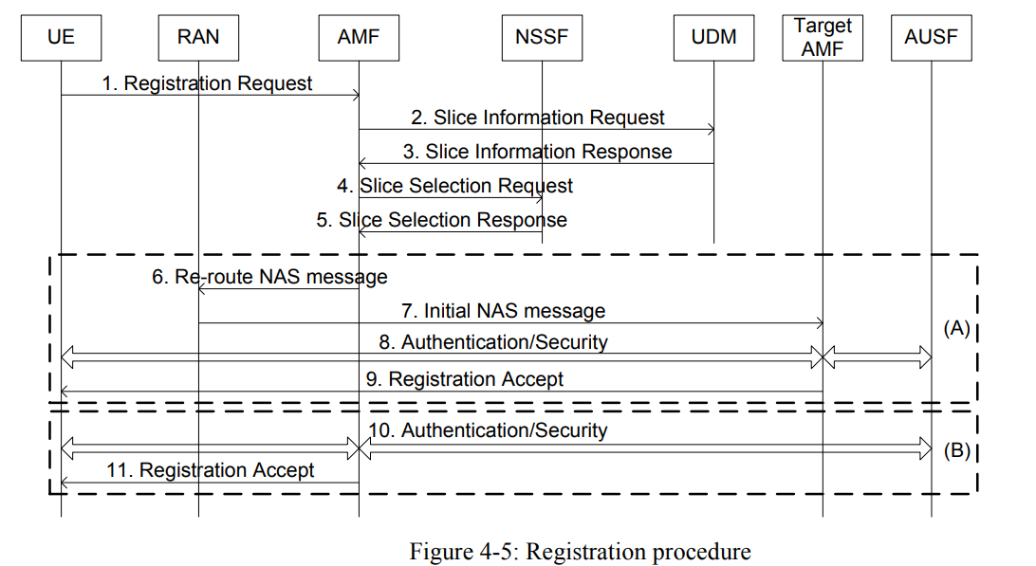
Core Network Slicing Registration
Notes:
UE sends Registration Request to AMF. The message includes requested NSSAI.
AMF sget subscription data from UDM.
UDM responds subscription data to AMF. The subscribed NSSAI includes subscribed S-NSSAI
AMF sends Slice Selection Request to NSSF to select slice for UE. The message includes requested NSSAI, subscribed NSSAI, UE location.
NSSF determines allowed NSSAI and selects target AMF based on information provided by AMF. NSSF sends Slice Selection Response to AMF. The message includes allowed NSSAI，mapping between the S-NSSAI in the Allowed NSSAI and the NRF and AMF list. The AMF list may include AMF IP address list or FQDN list. AMF determines whether it is the target AMF based on whether it is included in the AMF list. If it is the target AMF, then the steps in box (B) are performed, the steps in box (A) are skipped. Otherwise the steps in box (A) are performed, the steps in box (B) are skipped.
AMF determines that it is not the target AMF, it sends Re-route NAS message to RAN. The message includes the Registration Request and the identifier of the target AMF.
RAN sends the Registration Request to the target AMF.
Authentication and security are performed.
Target AMF sends Registration Accept message to UE.
AMF determines that it is the target AMF. Authentication and security are performed.
AMF sends Registration Accept message to UE.

Slide 11
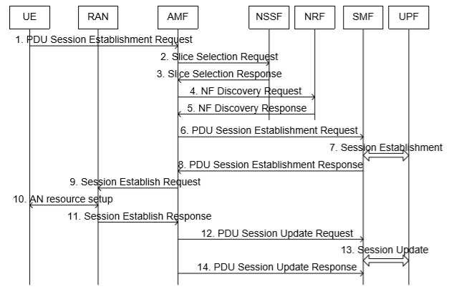
Core Network Slicing PDU Session Establishment
Notes:
UE sends PDU Session Establishment Request to AMF. The message includes requested S-NSSAI I in the Allowed NSSAI.
AMF sends NF Discovery Request to NRF based on the mapping between the S-NSSAI and the NRF returned during registration procedure, the message includes requested S-NSSAI.
NRF selects SMF and sends the NF Discovery Response to AMF. The message includes SMF ID.
AMF sends the PDU Session Establishment Request to SMF.
SMF selects UPF and establishes session.
SMF sends PDU Session Establishment Response to AMF. The message includes the tunnel information of the UPF.
AMF sends the Session Establishment Request to RAN. The message includes tunnel information of the UPF
RAN establishes AN resource for the PDU session.
RAN sends Session Establishment Response to AMF. The message includes tunnel information of the RAN.
AMF sends PDU Session Update Request to SMF. The message includes tunnel information of the RAN.
SMF sends the tunnel information of the RAN to UPF.
SMF sends PDU Session Update Response to AMF.
Then the NSSF in VPLMN returns the NRF in HPLMN and NRF in VPLMN to AMF. The AMF sends the requested S-NSSAI and NRF in HPLMN to NRF in VPLMN. The NRF in VPLMN selects SMF in VPLMN and sends requested S-NSSAI to NRF in HPLMN. The NRF in HPLMN selects the SMF in HPLMN and send the ID of the SMF to the NRF in VPLMN. After receiving the ID of the SMF in HPLMN, the NRF in VPLMN sends the two SMFs to AMF.

Slide 12
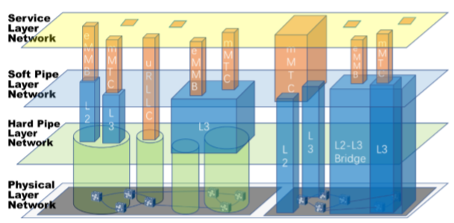
Transport Network Slicing
Physical Layer Network: physical resource, such as rack, port and fiber link etc.
Hard Pipe Layer Network: L1 hard pipe and can’t statically multiplex
Soft Pipe Layer Network: L2 or L3 network, such as Ethernet or IP network
Service Layer Network: represents client layer network of transport network
Notes:
With the development of 5G, it raised the following technical requirements for the transport network:
Large bandwidth: to meet requirements of eMBB, 5G base station density and single station capacity are greatly raised, and there appears demand for higher data rate and lager capacity of the transport network. Low latency: the URLLC makes strict demands on the forwarding delay of the transport network. Network slicing: in the age of 5G, the same transport network needs to support services of eMBB, URLLC and mMTC etc., and needs slicing network for different services. Flexible scheduling of the services: for the separately placement of 5G Centralized Unit/Distributed Unit (CU/DU), MEC subsidence, virtualization, etc., the transport network needs to provide inter-cloud connectivity and connection-oriented carrier grade packet transport.

Slide 13



5G Security Architecture
Major risks:
More IoT devices will be attacked.
- Data Theft
- DoS
Untrusted hardware providers.
- Industry 4.0
- National security
Notes:
- Risk: https://5g-ppp.eu/wp-content/uploads/2014/02/5G-PPP_White-Paper_Phase-1-Security-Landscape_June-2017.pdf
AKA Protocol: https://eprint.iacr.org/2018/1175.pdf#page=1&zoom=auto,-47,800

Slide 14
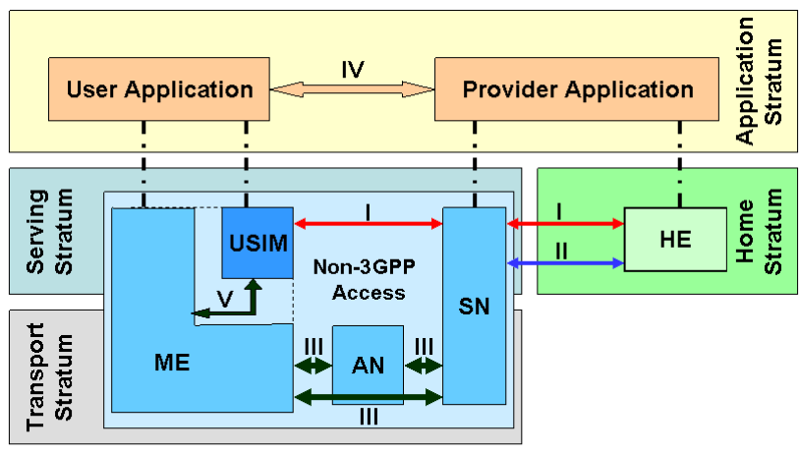
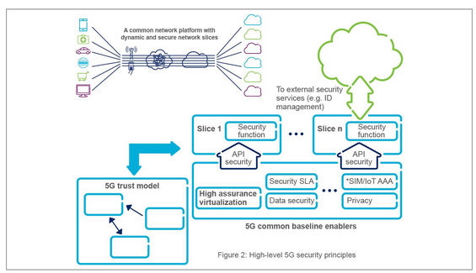
5G Security Architecture (cont.)
New trust model
- Base on 3G, 4G-LTE security architecture.
- Improve AKA protocol.
Need to have distinct security for each network slide.
Select trusted and mixed hardware providers.
Self-researching and manufacturing for each country.
Notes:
- Risk: https://5g-ppp.eu/wp-content/uploads/2014/02/5G-PPP_White-Paper_Phase-1-Security-Landscape_June-2017.pdf
AKA Protocol: https://eprint.iacr.org/2018/1175.pdf#page=1&zoom=auto,-47,800

Slide 15
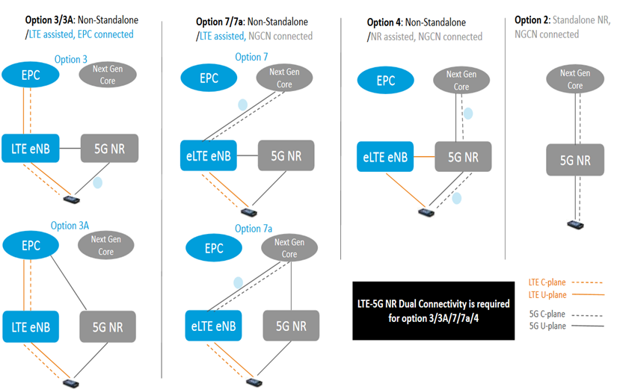
3GPP 5G Deployment Options

Slide 16
Reference
[1] NGMN Alliance: "Description of Network Slicing Concept", Version 1.0, January 13, 2016
[2] 3GPP TS 23.501: “System Architecture for the 5G System”
[3] 3GPP TR 23.799: “Study on Architecture for Next Generation System”
[4] White Paper: “5G Network Slicing for Vertical Industries”, Global mobile Suppliers Association, Sept., 2017.
[5] White Paper: “5G Performance-Guaranteed Network Slicing Service”, CMCC, Huawei, March, 2017
[6] 3GPP TR 38.300: “NR and NG-RAN Overall Description; Stage 2”

Slide 17

Q&A

Slide 18

THANK YOU !
Tel:
Mobile:
Fax:
Email:
+84 8 3997-8000
+84 908-676-212
+84 8 3990-3303
sales@tmasolutions.com
North America number:
Australia number:
Japan number:
Website:
+ 1 802-735-1392
+ 61 414-734-277
+81 3-6432-4994
www.tmasolutions.com

Slide 19
Backup Slide #1
Notes:
5G-PPP-5G-Architecture-White-Paper-Jan-2018-v2.0.pdf

Slide 20
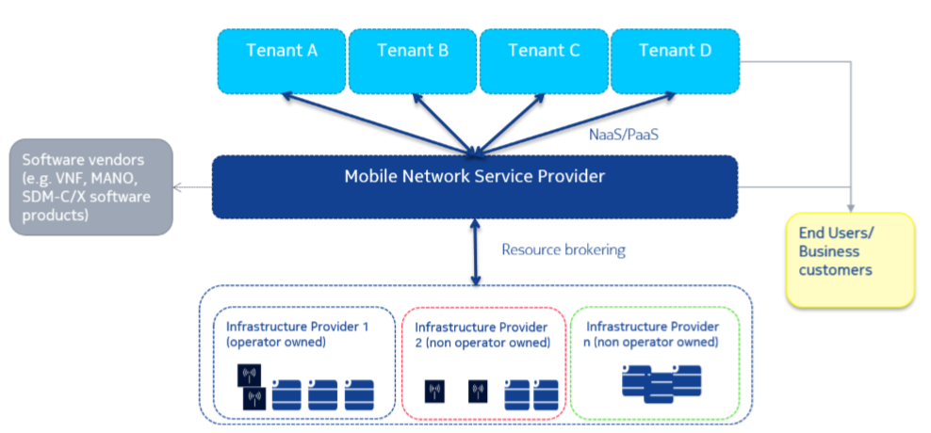
Backup Slide #2
Notes:
5G-PPP-5G-Architecture-White-Paper-Jan-2018-v2.0.pdf

Slide 21
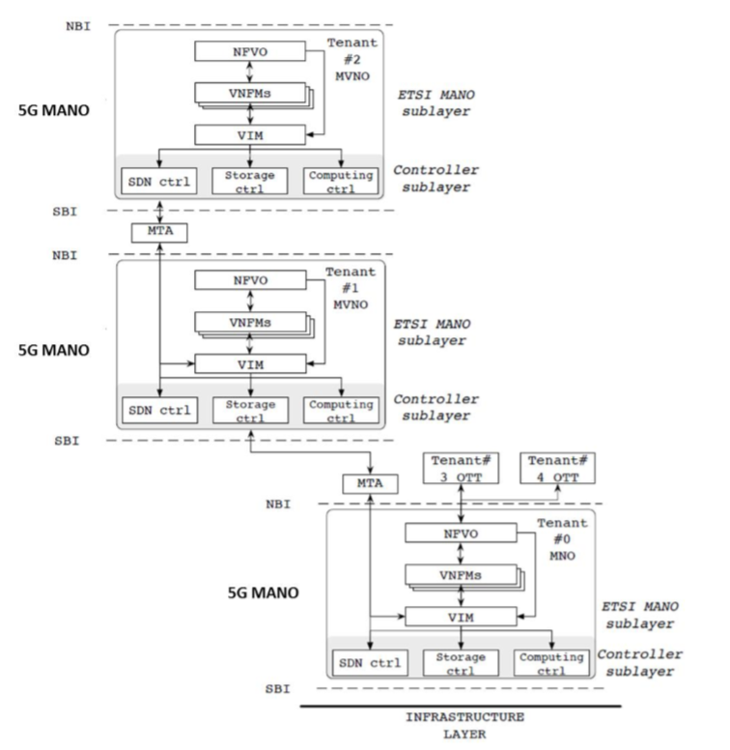
Backup Slide #3
ECHO-761
Notes:
5G-PPP-5G-Architecture-White-Paper-Jan-2018-v2.0.pdf

Slide 22
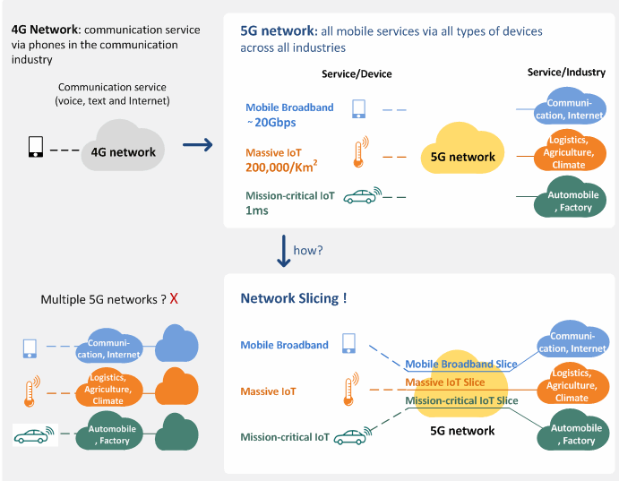
Backup slide #4
Notes:
https://www.netmanias.com/en/post/blog/8325/5g-iot-network-slicing-sdn-nfv/e2e-network-slicing-key-5g-technology-what-is-it-why-do-we-need-it-how-do-we-implement-it

